Slide 1





An Introduction to + express
Keith Chester
thekeithchester
hlfshell
keithchester

Slide 2
Welcome to the community
node.jSTL meets at least once a month
We try to make talks good for experts and beginners
Open floor time to talk to experts, ask for help on projects, get resources to learn
“Classes” like this is new, and we’d like your feedback to have more
jSTL coming soon!
General Javascript meetup to incorporate ALL front end frameworks + node
Work in progress
Join STL-Tech slack! stltech.herokuapp.com to get an invite
#node channel Is connected to other slack groups around the world
@keithchester is my username there

Slide 3

Who the heck am I
Head of Research and Development + and an Application Developer at
I use node.js everyday for websites, tablet apps, robots, hardware control, heart rate monitoring, light control, sound effects, beer measuring, nerf wars, video games, computer vision, augmented reality, image manipulation, home automation, wifi tracking, microservices, e-mail handling, chat bots, artificial intelligence, streaming video, big data, drink mixing (really), beach selfies, bit torrent, blockchain, distributed networking, mesh radio networking, permanent web…
and much more

Slide 4
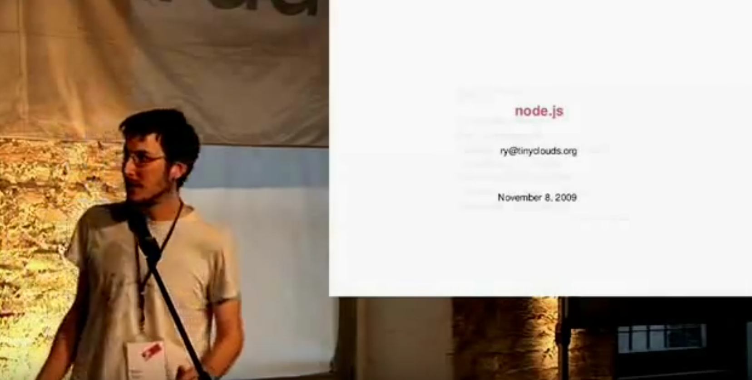
The briefest of histories
Ryan Dahl announces node.js in 2009 – a “side project” he was working on since he was unemployed. He was employed shortly after just to work on node.js

Slide 5
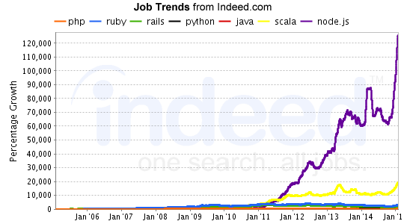
Popularity

Slide 6



There was some messiness

Slide 7






In good company

Slide 8
node.js – the hello worlds
To the terminal!

Slide 9
Core Modules
fs
path
utils
crypto
http
https
net
os
process
stream
url
console
timers
child_process
cluster
dns
querystring
module
…and a bunch more

Slide 10
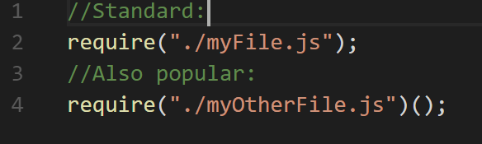
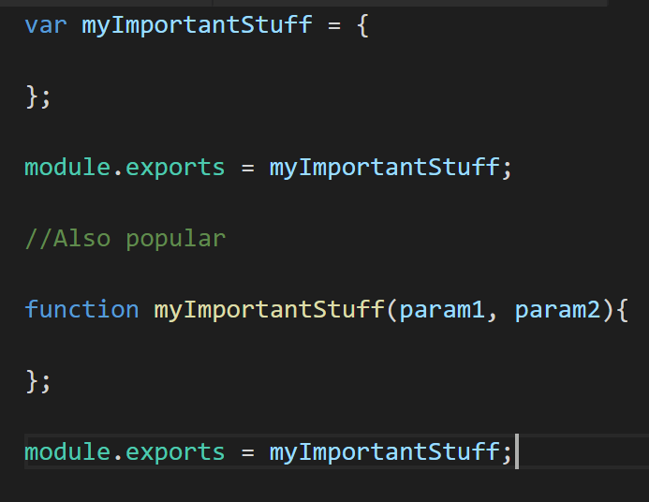
The Basics
require( )

Slide 11

The Basics
npm
400,000 modules

Slide 12
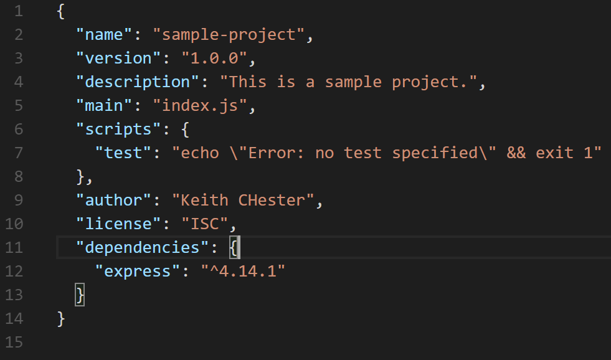
The Basics
starting our project
npm init

Slide 13
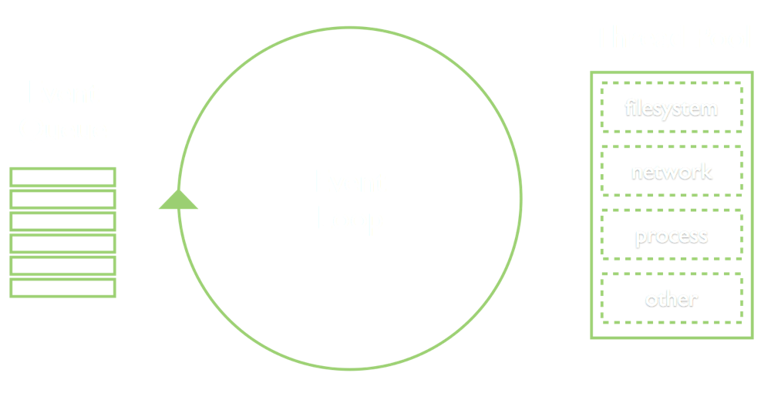
The event loop

Slide 14
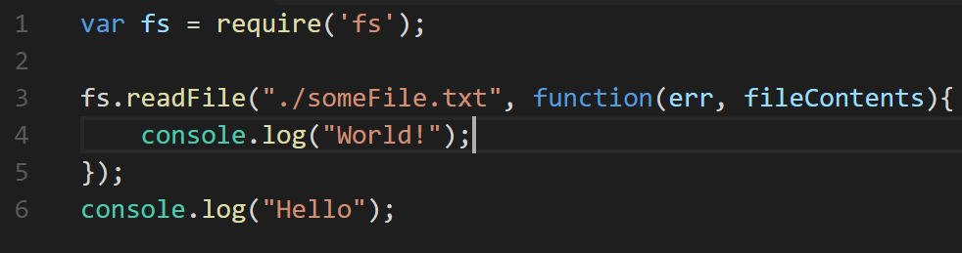
The event loop

Slide 15
A hello world in express

Slide 16
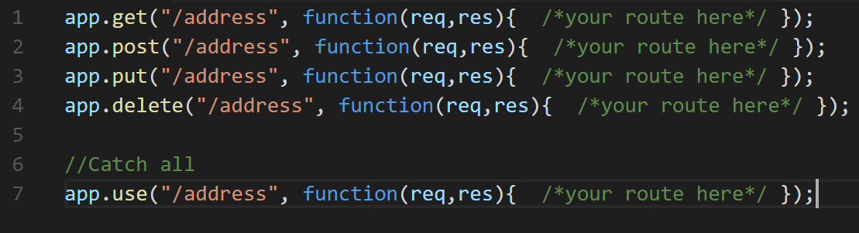
Routing

Slide 17
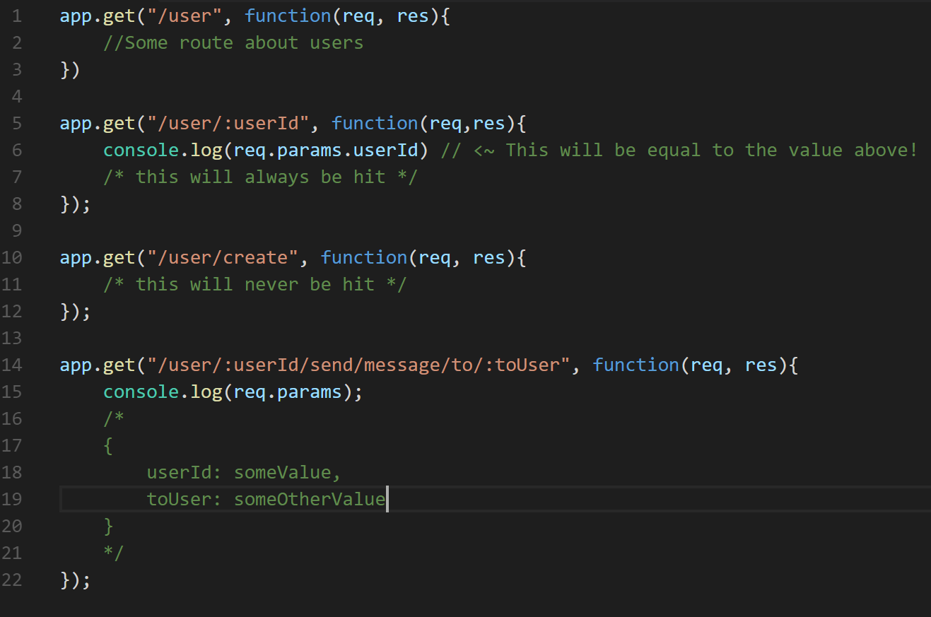
Routing w/ Parameters

Slide 18
req attributes
originalUrl
params
hostname
method
is
get
cookies
body

Slide 19
res
send
end
status

Slide 20
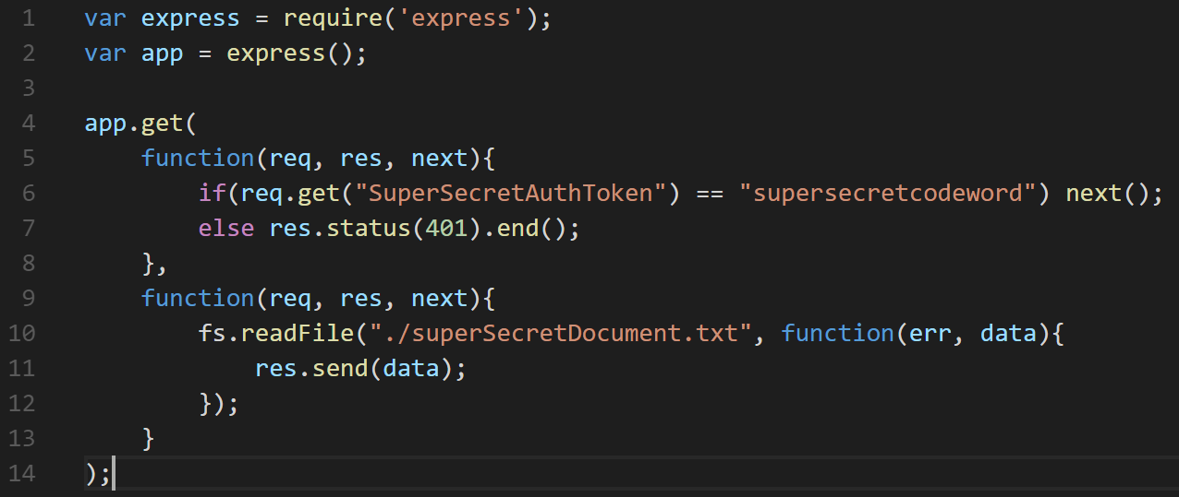
Middleware

Slide 21
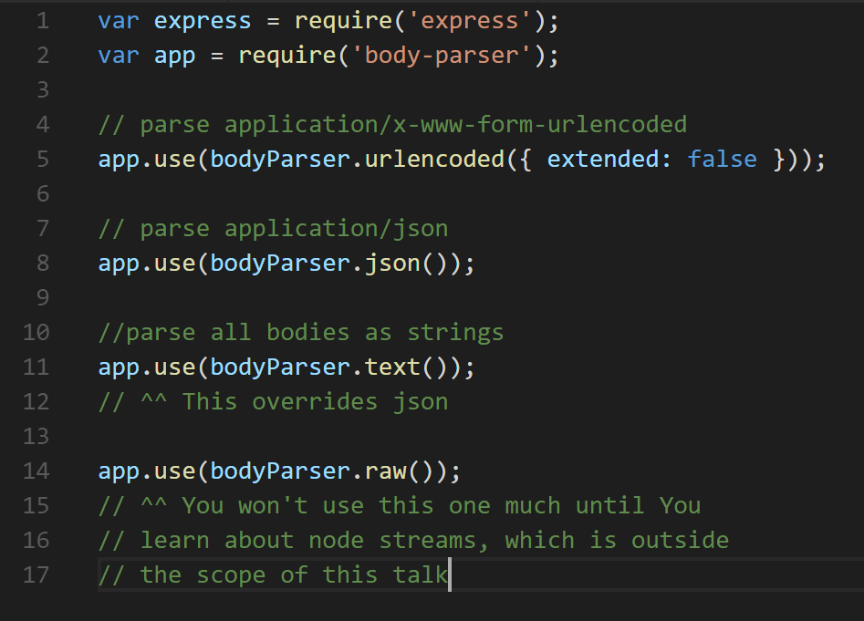
body-parser

Slide 22
Popular middleware
multer
cookie-parser
cookie-session
cors
express.static
timeout
morgan
passport

Slide 23
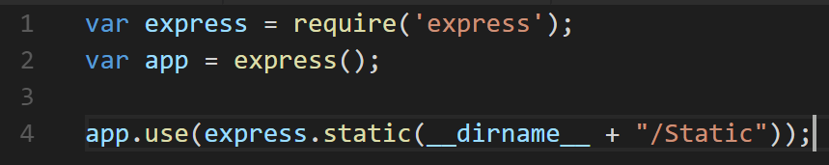
Static content made easy

Slide 24
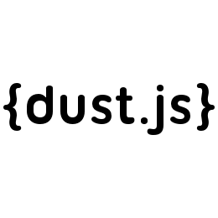



Template engines

Slide 25
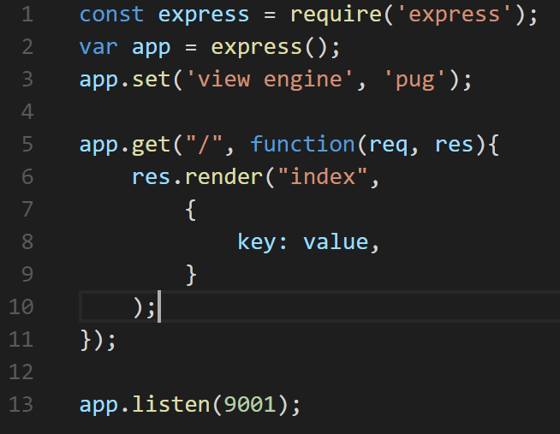
Serving up templates

Slide 26









Databases

Slide 27
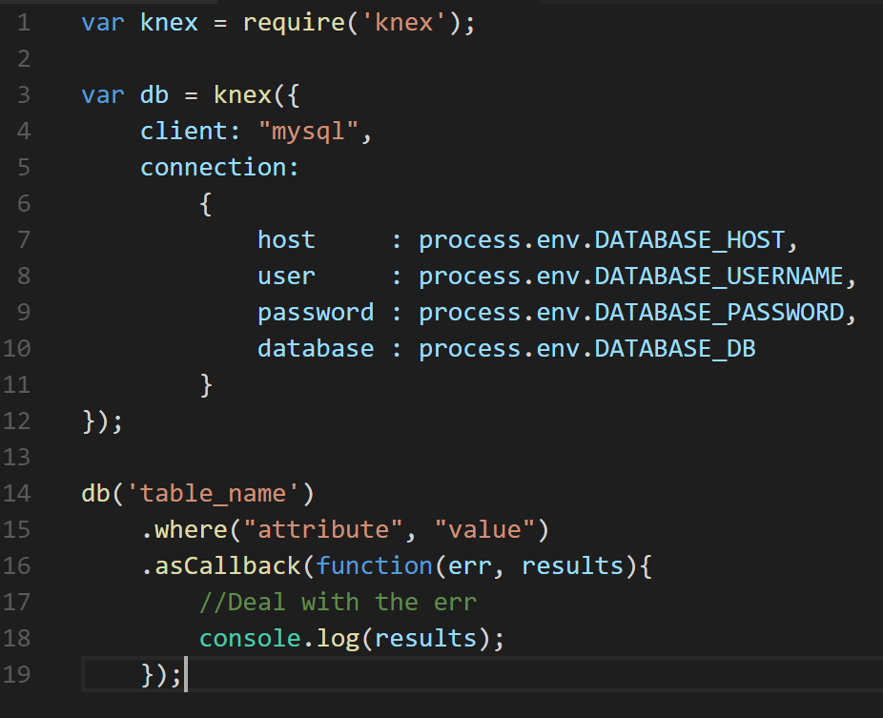
Example Knex Query

Slide 28

Congratulations!

Slide 29
Now we build
…a crappy twitter clone
Warning: live coding ahead
Stuff WILL go wrong

Slide 30
Questions?
Everything we did can be found at
github.com/hlfshell/node.jSTL-Intro-Series---An-Introduction-to-Express
Look for node.jSTL on Youtube!

